Slide 1
Robotic Deep Rolling
16 August 2019
Glenn Saunders

Slide 2
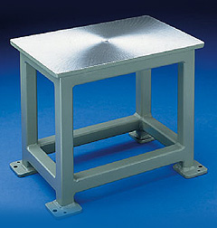
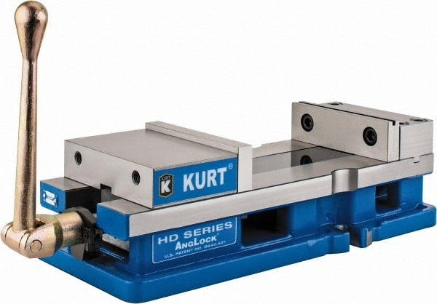
Work Surface
48” x 48” x 30” tall Brute base on order. Expected next week. Base bolts to floor.
6” Kurt Vise received
Expecting to send out for tapped mounting holes on a grid pattern after receipt.

Slide 3
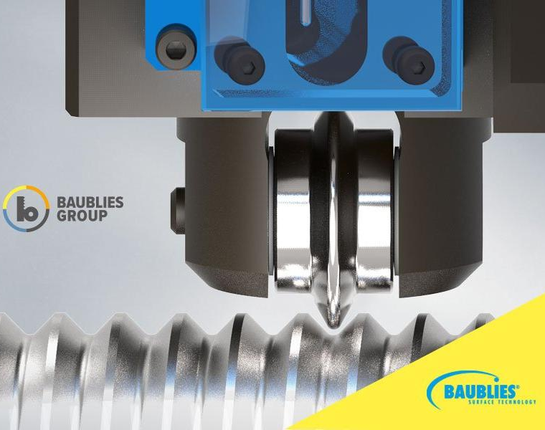
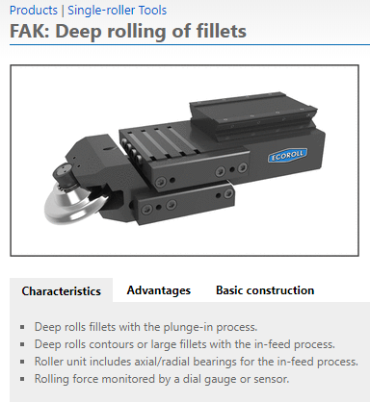
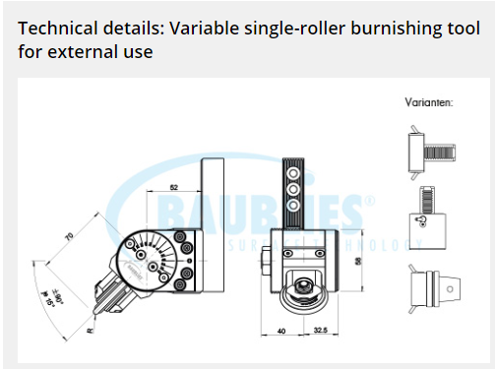
Deep Rolling Tooling
Commercial tooling similar to UTRC custom tooling: Ecoroll FAK and Baubles Single Roller shown here.
UTRC uses custom holder and roller design. I recommend that RPI replicates UTRC design.
OK to share design files?

Slide 4
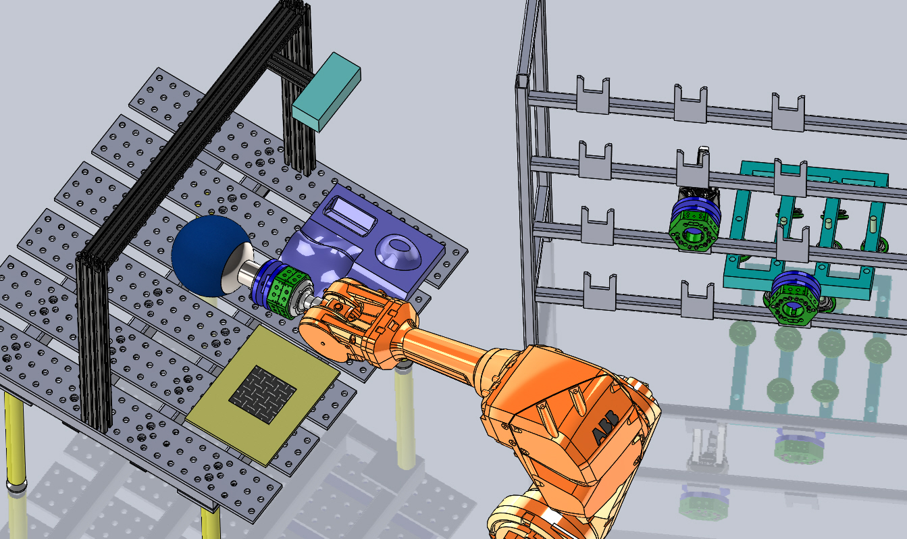
For Discussion: Tool Changer
Tool changer needed for GE 3-D Draping Project.
Tool changer simplifies setup changes between 3 active projects involving IRB 6640.
Applied Robotics E100 tool changer proposed.
120kg payload.
IRB 6640: 180kg.
Need to discuss Deep Rolling load vector axial vs offset. Load capacity in axial direction likely higher than offset loads.
Tool changer
ABB IRB 4600 shown

Slide 5
Current Status
Near-term testbed punch list:
Finish bolting down ABB robot (next week).
Select work table & fixturing (vise), place orders.
Clean out smaller work table currently in testbed space.
Rework vacuum gripper for registration pins (for ease of remove/replace).
Select burnishing tool, design end effector.

